Slide 1

Page Object Model

Slide 2

Objectives
Selenium Overview
Page Object
Why do we need it
Demo
Selenium main actions.

Slide 3





Selenium Overview
Selenium automates browsers. That's it!

Slide 4

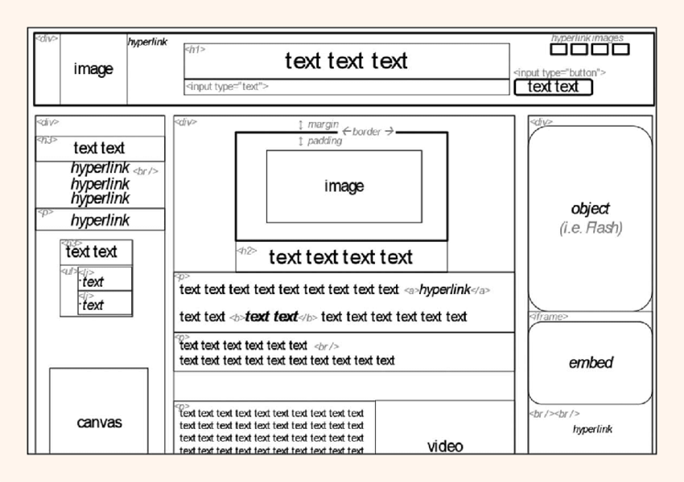
Selenium main actions
Everything is an element
Once we found it:
We need to find it
Find Element
Get text
Send keys
Click

Slide 5
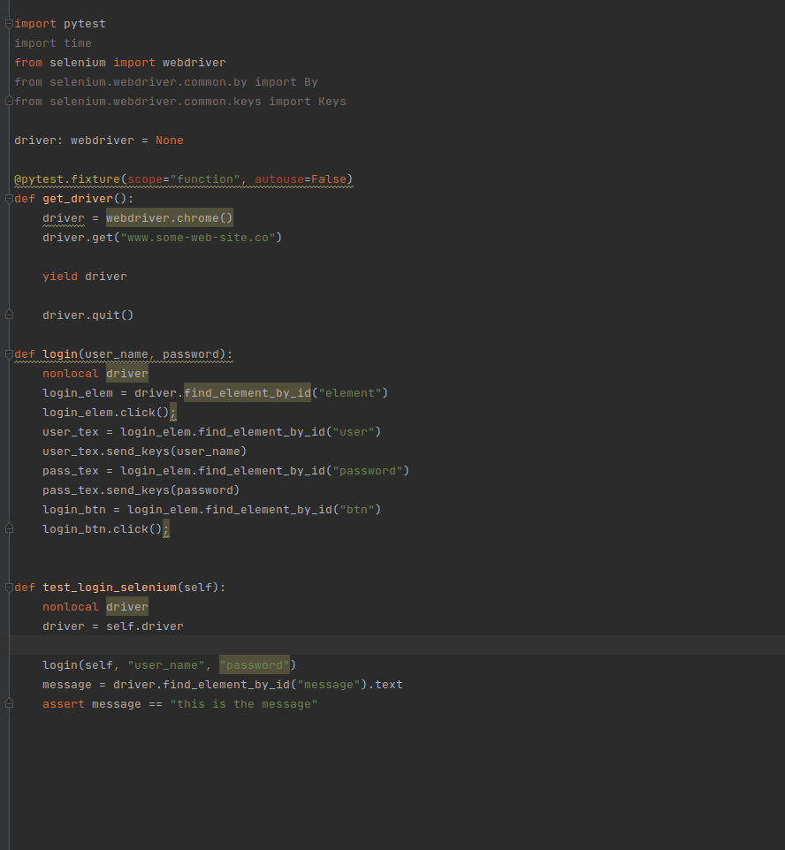
Example
Page = www.some-web-site.co
ID = element
ID = user
ID = password
ID=btn

Slide 6
Page object Modole
What is POM
Why do we need it
Design pattern.
Easy maintenance
Reusing code
Make tests readable
Each page (menu).. Is Represented by object

Slide 7
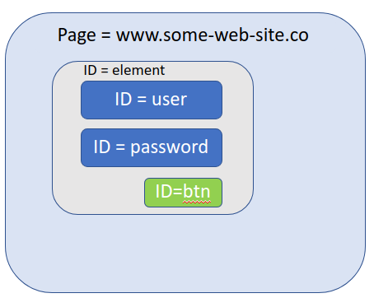
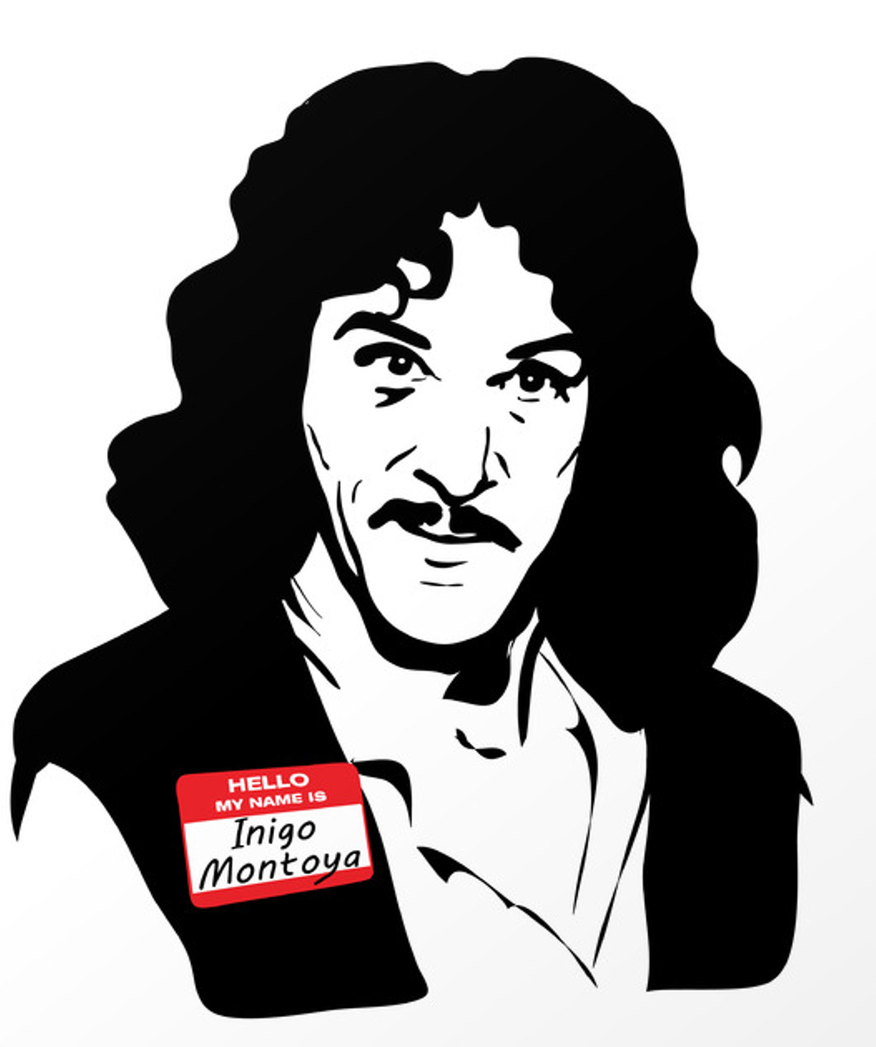
Login page
My account page
My account
Name: Inigo Montoya
Other button
Home
Home
Open mainpage
Login with user and pass
Login page open
Click on "My account" button
My account page open
Validae name equal Inigo Montoya

Slide 8
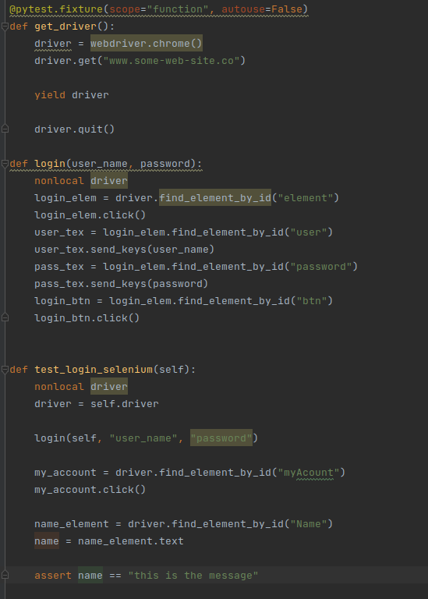
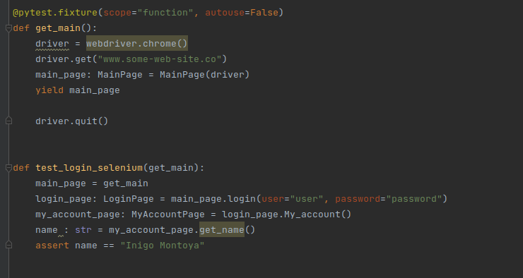
With and without POM
Open mainpage
Login with user and pass
Login page open
Click on "My account" button
My account page open
Validae name equal Inigo Montoya

Slide 9
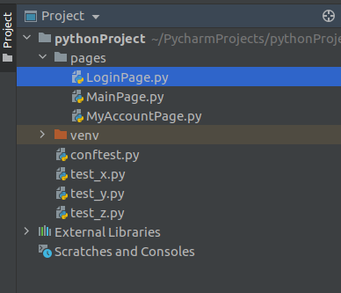
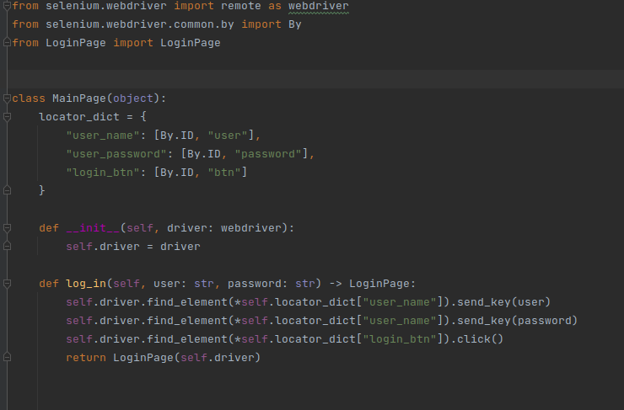
Page Example
Locators
As array of tuples
Constractor
Get the driver
Functions
Will usually return a new Page

